Slide 1
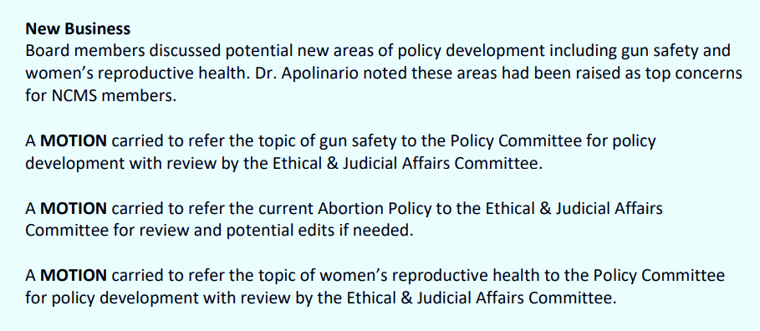
NCMS BOARD of DIRECTORS’ POLICY CHARGE

Slide 2
Recommendations of the Subcommittee
Sunset the existing NCMS Abortion policy and replace with the proposed Access to Comprehensive Reproductive Health Care policy
NCMS Staff to create a companion document for educational purposes and to address specific questions that may arise from members, stakeholders, legislators, and others.
The Policy Committee will continue their review and revision of the policies contained under the Public Health – Children Issues category, which includes multiple policies involving minor consent, access, and reproductive education.
Existing NCMS Policies Related to the Draft Policy
Abortion
Access to Care and Social Supports for All Populations
National CLAS Standards
Education and Emergency Contraception
Health Equity
Preconception and Reproductive Health Education to Women and Men
Maternal and Infant Health
Physicians’ Roles as Patient Advocates
Physician Refusal to Treat
Public Health in North Carolina
Minors’ Consent for Certain Medical Health Services*
Services for Minors*
Criminalization of Medical Acts
*Part of the Public Health – Children’s Issues category, being reviewed by the Policy Committee

