Slide 1
Value Driven Healthcare
PINEHURST SURGICAL

Slide 2
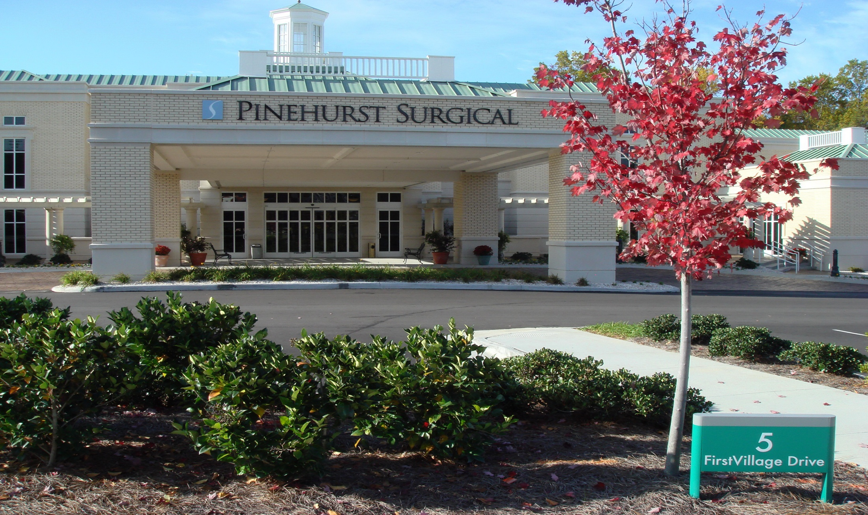
PINEHURST SURGICAL

Slide 3
Value Driven Healthcare
patient satisfaction (p-g)
Referral source satisfaction
Hospital employee satisfaction
Physician peer review
Organizational kpi
Meaningful use measurements
Financial: tdabc
Clinical: outcomes

Slide 4
Patient Comment Format
Office Site
Dept
Category- (Patient Care, Scheduling,Wait time, Positive, Negative)
Provider
EMR #
Comments Suggestions in Improving the lab process
Your test/treatments comments
Please tell us how your provider or Pinehurst Surgical could have improved the care and services you received.

Slide 5
Pinehurst Surgical - Survey Responses - September, 2012
 |  |  | Medical Providers |  |  |  | Nurse |  | Dept | Secretaries/Schedulers |  |  | Registration Process / Business Office |  |  |  | Ancillary Process |  | All | Medical Providers
Dept | Provider | Number of Surveys | Avg Rate - How Medical Provider explained things | Avg Rate - Medical Provider showed respect | Avg Rate - Medical Provider spent enough time with you | Avg Rate - Medical Provider listening skills | Avg Rate -Concern and respect of the nurse | Avg Rate - Nurse informed you delays while in exam rm. | Avg Rate - Wait time | Avg Rate - The scheduling process | Avg Rate - Helpfulness and courtesy of scheduler | Avg Rate - Responsiveness to returning call | Avg Rate - Manner greeted | Avg Rate - Registration staff courtesy and respect | Avg Rate - Speed and efficiency of registration process | Avg Rate - Receptionist informed you about any delays? | Avg Rate - The Lab testing process | Avg Rate - The Diagnostic testing process | Avg Rate - Cleanliness & appearance of the office | Avg Rate - Likelihood to Recommend Medical Provider | Avg Rate -Overall Medical Provider Rating | Overall average (Dept & PSC weighted avg)
ENT | Berk | 26 | 9.85 | 9.81 | 9.65 | 9.73 | 9.88 | 9.48 | 9.15 | 9.12 | 9.58 | 9.73 | 9.19 | 9.19 | 9.31 | 9.18 | 9.64 | 9.86 | 9.85 | 9.80 | 9.72 | 9.56
ENT | Cox | 11 | 9.55 | 9.73 | 9.73 | 9.73 | 9.64 | 9.13 | 9.09 | 9.55 | 9.60 | 9.50 | 9.73 | 9.64 | 9.55 | 9.25 |  |  | 9.64 | 9.91 | 9.91 | 9.58
ENT | Kilpatrick | 18 | 9.67 | 9.72 | 9.67 | 9.72 | 8.88 | 8.44 | 8.61 | 8.82 | 9.41 | 9.13 | 9.28 | 9.33 | 9.39 | 8.80 | 9.00 | 10.00 | 9.56 | 9.82 | 9.76 | 9.32
ENT | McGuirt | 37 | 9.33 | 9.25 | 9.06 | 9.28 | 9.00 | 7.90 | 8.54 | 8.97 | 9.09 | 8.97 | 8.47 | 8.67 | 8.19 | 7.91 | 7.89 | 9.50 | 9.42 | 9.53 | 9.38 | 8.86
ENT | Riefkohl | 24 | 9.54 | 9.67 | 9.63 | 9.58 | 9.54 | 9.33 | 8.83 | 9.67 | 9.52 | 9.10 | 9.75 | 9.75 | 9.35 | 9.25 | 9.83 | 9.00 | 9.63 | 9.83 | 9.78 | 9.50
ENT-ML | Haywood | 16 | 9.94 | 10.00 | 10.00 | 10.00 | 10.00 | 9.92 | 9.88 | 10.00 | 10.00 | 9.75 | 10.00 | 10.00 | 10.00 | 10.00 |  | 10.00 | 9.88 | 10.00 | 10.00 | 9.96
ENT-ML | Rose | 16 | 9.50 | 9.53 | 9.43 | 9.50 | 9.29 | 8.73 | 8.13 | 9.13 | 9.27 | 9.29 | 9.13 | 9.20 | 9.13 | 8.54 | 10.00 | 10.00 | 9.64 | 9.60 | 9.64 | 9.30
ENT-ML | Whitlock | 5 | 8.80 | 8.00 | 7.20 | 8.00 | 8.00 | 8.25 | 8.20 | 8.50 | 8.50 | 8.50 | 8.60 | 8.80 | 8.80 | 6.50 | 5.00 | 10.00 | 8.40 | 7.00 | 7.60 | 8.03
GSU | Alzamora | 15 | 9.73 | 9.73 | 9.73 | 9.73 | 9.67 | 9.36 | 9.00 | 8.93 | 9.07 | 9.15 | 9.33 | 9.33 | 9.47 | 9.36 | 7.33 | 9.29 | 9.67 | 9.93 | 9.80 | 9.35
GSU | Chu | 8 | 9.50 | 9.63 | 9.63 | 9.63 | 9.63 | 9.50 | 9.38 | 9.63 | 9.63 | 9.50 | 9.50 | 9.50 | 9.50 | 9.38 | 9.00 | 9.00 | 9.63 | 9.75 | 9.63 | 9.50
GSU | Fessenden | 11 | 9.27 | 9.55 | 9.45 | 9.55 | 9.64 | 9.18 | 8.45 | 9.82 | 9.80 | 9.89 | 9.73 | 9.73 | 9.64 | 8.36 | 9.00 | 10.00 | 9.64 | 9.91 | 9.91 | 9.50
GSU | Grantham | 20 | 9.71 | 9.83 | 9.83 | 9.76 | 9.74 | 9.69 | 9.21 | 9.05 | 9.47 | 9.16 | 9.68 | 9.68 | 9.50 | 9.71 | 9.00 | 10.00 | 9.74 | 9.53 | 9.53 | 9.57
GSU | Jeyapalan | 8 | 9.13 | 8.88 | 8.88 | 9.13 | 9.13 | 8.57 | 7.75 | 9.29 | 9.43 | 9.20 | 8.88 | 8.75 | 8.38 | 7.67 |  | 8.83 | 9.50 | 9.13 | 9.00 | 8.86
GSU | Steiner | 7 | 8.43 | 8.57 | 8.57 | 8.57 | 9.29 | 9.71 | 9.71 | 10.00 | 10.00 | 10.00 | 10.00 | 10.00 | 10.00 | 10.00 | 10.00 | 9.75 | 9.43 | 8.33 | 8.00 | 9.39
GSU | Washington | 18 | 9.50 | 9.56 | 9.44 | 9.56 | 9.06 | 8.57 | 8.00 | 9.38 | 9.33 | 9.58 | 8.89 | 9.00 | 8.82 | 8.31 | 10.00 | 9.83 | 9.44 | 9.56 | 9.50 | 9.23
ORT | Brenner | 45 | 8.91 | 8.98 | 8.58 | 8.78 | 8.61 | 6.79 | 5.56 | 8.66 | 8.79 | 8.54 | 9.04 | 9.04 | 8.87 | 6.75 | 9.11 | 8.00 | 9.29 | 9.04 | 8.61 | 8.42
ORT | Casey | 24 | 9.43 | 9.27 | 9.14 | 9.18 | 9.15 | 7.55 | 6.82 | 8.82 | 9.05 | 8.68 | 8.86 | 8.77 | 8.62 | 7.90 | 7.75 | 8.29 | 9.38 | 9.29 | 9.37 | 8.70
ORT | Conti | 30 | 9.13 | 9.31 | 8.90 | 9.20 | 8.79 | 8.04 | 8.03 | 9.46 | 9.46 | 9.12 | 9.37 | 9.33 | 9.37 | 8.38 | 9.58 | 9.67 | 9.67 | 9.45 | 9.13 | 9.13
ORT | Eaton | 18 | 9.13 | 8.81 | 8.75 | 8.88 | 7.75 | 7.44 | 7.38 | 8.76 | 8.82 | 8.47 | 8.89 | 9.06 | 9.28 | 8.18 | 9.00 | 10.00 | 9.12 | 9.07 | 8.93 | 8.72
ORT | Fedder | 20 | 9.37 | 9.26 | 8.95 | 9.21 | 9.33 | 7.50 | 6.79 | 9.42 | 9.53 | 9.44 | 9.61 | 9.63 | 9.16 | 7.61 | 9.75 | 9.50 | 9.63 | 9.28 | 9.00 | 9.05
ORT | Moore | 46 | 9.71 | 9.80 | 9.52 | 9.70 | 9.70 | 8.95 | 8.30 | 9.54 | 9.64 | 9.46 | 9.42 | 9.42 | 9.40 | 8.41 | 7.00 | 9.00 | 9.72 | 9.93 | 9.82 | 9.29
ORT | Oakley | 20 | 9.15 | 9.25 | 9.10 | 9.25 | 9.25 | 8.21 | 7.40 | 9.15 | 9.30 | 9.00 | 9.25 | 9.45 | 9.45 | 8.35 | 10.00 | 9.33 | 9.60 | 9.83 | 9.53 | 9.15
ORT | Strom | 33 | 8.45 | 8.27 | 7.37 | 7.81 | 8.81 | 7.52 | 6.75 | 9.45 | 9.53 | 9.41 | 9.33 | 9.19 | 9.36 | 8.19 | 9.67 | 9.50 | 9.31 | 7.70 | 7.58 | 8.59
ORT | Washington,T | 15 | 9.87 | 9.87 | 9.67 | 9.87 | 9.67 | 9.58 | 8.20 | 9.60 | 9.60 | 9.20 | 9.33 | 9.33 | 8.64 | 8.67 | 10.00 | 8.33 | 9.67 | 9.93 | 9.60 | 9.40
ORT | Wohlrab | 29 | 9.59 | 9.79 | 9.45 | 9.66 | 9.52 | 7.81 | 7.62 | 9.50 | 9.61 | 9.28 | 9.28 | 9.41 | 9.17 | 8.32 | 9.33 | 10.00 | 9.72 | 9.86 | 9.83 | 9.30
ORT-ML | Blatz | 12 | 9.75 | 9.92 | 9.75 | 9.92 | 9.58 | 8.82 | 8.08 | 8.83 | 9.08 | 8.67 | 9.17 | 8.83 | 8.83 | 8.45 | 9.80 | 9.67 | 9.58 | 9.92 | 9.83 | 9.29
ORT-ML | Keller | 18 | 9.12 | 9.06 | 9.18 | 9.12 | 9.06 | 7.13 | 7.41 | 8.67 | 9.00 | 9.00 | 9.18 | 9.29 | 8.94 | 7.13 | 8.88 | 5.00 | 9.35 | 9.50 | 9.47 | 8.60
ORT-ML | Martinez | 7 | 9.57 | 9.57 | 9.71 | 9.57 | 9.14 | 8.86 | 8.86 | 9.57 | 9.86 | 9.57 | 9.71 | 9.86 | 9.57 | 9.86 | 10.00 | 8.50 | 9.86 | 9.67 | 9.67 | 9.53
ORT-ML | Tighe | 11 | 9.73 | 9.82 | 9.82 | 9.80 | 9.64 | 9.20 | 9.00 | 8.89 | 9.44 | 9.44 | 8.82 | 8.82 | 8.55 | 9.11 | 9.00 | 10.00 | 9.45 | 9.91 | 9.64 | 9.37
Plastics | Stokes | 12 | 9.73 | 9.92 | 9.91 | 9.92 | 9.91 | 9.44 | 9.33 | 9.91 | 10.00 | 10.00 | 9.91 | 9.92 | 9.92 | 9.40 | 10.00 | 10.00 | 9.73 | 9.67 | 9.91 | 9.82
Uro | Chamberlain | 31 | 9.70 | 9.80 | 9.83 | 9.77 | 9.57 | 9.22 | 8.60 | 9.55 | 9.79 | 9.64 | 9.37 | 9.50 | 9.40 | 8.82 | 9.58 | 9.86 | 9.77 | 9.90 | 9.87 | 9.55
Uro | Goetzel | 21 | 9.52 | 9.48 | 9.43 | 9.57 | 9.75 | 8.86 | 8.90 | 9.63 | 9.72 | 9.63 | 9.67 | 9.71 | 9.75 | 9.33 | 9.60 | 10.00 | 9.43 | 9.67 | 9.47 | 9.53
Uro | Griewe | 34 | 9.50 | 9.58 | 9.27 | 9.47 | 9.00 | 7.57 | 7.15 | 8.86 | 8.93 | 8.79 | 9.38 | 9.61 | 9.32 | 8.00 | 9.28 | 9.33 | 9.63 | 9.15 | 9.15 | 9.00
Uro | Lenahan | 18 | 9.28 | 9.06 | 9.39 | 9.17 | 9.28 | 9.00 | 8.59 | 9.29 | 9.41 | 9.35 | 9.22 | 9.33 | 9.17 | 9.31 | 9.27 | 9.50 | 9.50 | 9.24 | 9.35 | 9.25
Uro | Stanfield | 11 | 9.45 | 9.73 | 9.45 | 9.64 | 9.45 | 9.14 | 9.27 | 9.60 | 9.67 | 9.57 | 9.36 | 9.45 | 9.18 | 9.50 | 9.22 | 10.00 | 9.64 | 9.91 | 9.64 | 9.52
Uro | White | 24 | 9.17 | 9.26 | 8.91 | 9.30 | 9.04 | 9.18 | 8.82 | 8.55 | 9.00 | 8.73 | 9.09 | 8.92 | 9.09 | 9.23 | 9.47 | 9.80 | 9.52 | 9.50 | 9.29 | 9.15
Vas | Albrecht | 4 | 9.75 | 9.75 | 9.75 | 9.75 | 9.75 | 9.75 | 8.75 | 7.50 | 8.00 | 8.67 | 8.75 | 8.00 | 7.75 | 7.50 |  | 9.00 | 9.50 | 9.75 | 9.75 | 8.97
Vas | Atkinson | 3 | 9.33 | 9.33 | 9.33 | 9.33 | 9.33 | 9.33 | 8.67 | 9.33 | 9.33 | 9.33 | 9.33 | 9.33 | 9.33 | 9.33 | 10.00 | 9.33 | 9.33 | 10.00 | 9.33 | 9.37
Vas | Berman | 9 | 10.00 | 10.00 | 10.00 | 10.00 | 10.00 | 9.71 | 9.33 | 9.13 | 9.71 | 9.57 | 9.89 | 10.00 | 9.78 | 10.00 | 7.50 | 10.00 | 10.00 | 10.00 | 10.00 | 9.72
Vas-ML | Poplin | 9 | 9.67 | 9.67 | 9.67 | 9.67 | 9.67 | 9.50 | 9.33 | 8.57 | 9.43 | 7.86 | 9.56 | 9.63 | 9.38 | 9.50 | 10.00 | 9.67 | 9.56 | 9.63 | 9.63 | 9.45
Vas-ML | Saunders | 21 | 9.00 | 9.10 | 9.05 | 9.10 | 9.00 | 9.11 | 8.50 | 9.00 | 9.00 | 9.00 | 9.30 | 9.42 | 8.80 | 8.79 | 7.80 | 9.77 | 8.53 | 9.16 | 9.10 | 8.97
WCC | Brooks | 9 | 9.67 | 9.78 | 9.78 | 9.78 | 9.00 | 7.78 | 6.22 | 8.56 | 9.50 | 8.75 | 9.33 | 9.50 | 7.56 | 7.63 | 7.60 | 9.20 | 9.33 | 8.67 | 8.89 | 8.76
WCC | Butawan | 11 | 8.40 | 8.90 | 8.10 | 8.90 | 8.91 | 7.64 | 6.64 | 9.36 | 9.55 | 8.44 | 9.09 | 9.09 | 8.91 | 7.27 | 8.33 | 10.00 | 9.55 | 8.38 | 8.63 | 8.64
WCC | Hardenbergh | 18 | 9.59 | 9.53 | 9.47 | 9.53 | 9.18 | 8.87 | 7.82 | 8.94 | 9.06 | 8.19 | 9.39 | 9.50 | 9.00 | 8.35 | 8.80 | 10.00 | 9.50 | 9.56 | 9.59 | 9.15
WCC | Szabo | 27 | 9.54 | 9.50 | 9.04 | 9.38 | 9.16 | 8.28 | 7.76 | 9.27 | 9.73 | 9.17 | 9.23 | 9.27 | 8.84 | 8.27 | 9.50 | 9.64 | 9.69 | 9.36 | 9.32 | 9.16
WCC | Terry | 23 | 8.86 | 9.05 | 8.55 | 8.86 | 9.10 | 8.52 | 7.57 | 8.68 | 8.68 | 8.52 | 9.05 | 9.09 | 8.68 | 8.95 | 8.63 | 9.40 | 9.55 | 8.95 | 9.15 | 8.83
WCC-ML | Phillips | 7 | 9.14 | 9.14 | 8.43 | 9.14 | 9.29 | 9.29 | 9.00 | 8.29 | 8.43 | 8.50 | 8.43 | 9.14 | 8.14 | 7.17 | 8.00 | 10.00 | 9.29 | 10.00 | 9.67 | 8.87
WCC-ML | Walling | 19 | 9.56 | 9.68 | 9.41 | 9.61 | 9.44 | 9.20 | 8.84 | 8.83 | 9.35 | 9.00 | 9.28 | 9.42 | 9.32 | 8.64 | 8.75 | 9.73 | 9.39 | 9.89 | 9.72 | 9.32
PSC Overall | W.Average | 879 | 9.39 | 9.43 | 9.23 | 9.37 | 9.26 | 8.50 | 8.07 | 9.16 | 9.34 | 9.11 | 9.28 | 9.32 | 9.13 | 8.48 | 9.15 | 9.48 | 9.53 | 9.47 | 9.38 | 9.16
Target |  |  | 9.50 | 9.56 | 9.40 | 9.50 | 9.55 | 9.00 | 9.07 | 9.35 | 9.40 | 9.30 | 9.65 | 9.45 | 9.30 | 8.91 | 9.45 | 9.45 | 9.70 | 9.63 | 9.65 | 9.41
PSC Percentage of Avg vs Target ¹ |  |  | 98.9% | 98.7% | 98.2% | 98.7% | 97.0% | 94.4% | 89.0% | 98.0% | 99.4% | 98.0% | 96.1% | 98.6% | 98.2% | 95.2% | 96.8% | 100.3% | 98.3% | 98.4% | 97.2% | 97.4%
Standard Deviation |  |  | 0.38 | 0.44 | 0.60 | 0.46 | 0.45 | 0.79 | 0.95 | 0.49 | 0.42 | 0.48 | 0.37 | 0.39 | 0.52 | 0.86 | 1.03 | 0.83 | 0.28 | 0.60 | 0.55 | 0.38
Lower Limit (psc avg - std dev) ² |  |  | 9.01 | 8.99 | 8.62 | 8.91 | 8.81 | 7.71 | 7.13 | 8.68 | 8.93 | 8.63 | 8.91 | 8.93 | 8.61 | 7.62 | 8.12 | 8.65 | 9.25 | 8.87 | 8.83 | 8.78
Upper Limit (psc avg + std dev) ² |  |  | 9.77 | 9.87 | 9.83 | 9.83 | 9.71 | 9.29 | 9.02 | 9.65 | 9.76 | 9.59 | 9.64 | 9.71 | 9.66 | 9.35 | 10.17 | 10.32 | 9.81 | 10.08 | 9.92 | 9.54
ENT Average |  | 153 | 9.57 | 9.57 | 9.44 | 9.54 | 9.37 | 8.85 | 8.82 | 9.24 | 9.41 | 9.27 | 9.21 | 9.27 | 9.11 | 8.78 | 8.93 | 9.67 | 9.59 | 9.66 | 9.62 | 9.32
Gen Surg Average |  | 87 | 9.44 | 9.51 | 9.48 | 9.52 | 9.47 | 9.22 | 8.75 | 9.35 | 9.47 | 9.44 | 9.40 | 9.41 | 9.31 | 8.99 | 9.00 | 9.62 | 9.59 | 9.54 | 9.46 | 9.37
Ortho Average |  | 328 | 9.28 | 9.29 | 8.99 | 9.18 | 9.11 | 7.94 | 7.35 | 9.18 | 9.32 | 9.08 | 9.23 | 9.24 | 9.12 | 8.04 | 8.99 | 8.91 | 9.51 | 9.36 | 9.18 | 8.96
Plastics Average |  | 12 | 9.73 | 9.92 | 9.91 | 9.92 | 9.91 | 9.44 | 9.33 | 9.91 | 10.00 | 10.00 | 9.91 | 9.92 | 9.92 | 9.40 | 10.00 | 10.00 | 9.73 | 9.67 | 9.91 | 9.82
Uro Average |  | 139 | 9.46 | 9.50 | 9.39 | 9.50 | 9.32 | 8.72 | 8.38 | 9.19 | 9.37 | 9.23 | 9.35 | 9.43 | 9.33 | 8.89 | 9.42 | 9.71 | 9.59 | 9.53 | 9.45 | 9.30
Vas Average |  | 46 | 9.41 | 9.46 | 9.44 | 9.46 | 9.41 | 9.37 | 8.86 | 8.83 | 9.16 | 8.88 | 9.42 | 9.44 | 9.05 | 9.09 | 8.36 | 9.70 | 9.15 | 9.52 | 9.45 | 9.24
WCC Average |  | 114 | 9.29 | 9.39 | 9.00 | 9.31 | 9.17 | 8.54 | 7.76 | 8.92 | 9.23 | 8.71 | 9.17 | 9.29 | 8.78 | 8.27 | 8.73 | 9.68 | 9.52 | 9.29 | 9.32 | 9.02
¹ Conditional Formatting (for PSC Avg vs Target): Green = more than 99.5% of target; Red = less than 98% of target |  |  |  |  |  |  |  |  |  | ² Conditional Formatting (for all Provider and Dept Values): Green = more than Upper Limit (1 std dev above norm); Red = less than Lower Limit (1 std dev below norm)

Slide 6
Sample Patient Comments
I had an x-ray and was comfortable with the process could not have been more sympathetic concerned better listeners or more determined to do what was possible to correct my issue Pinehurst Surgical Office
Very courteous and professional staff. Overall a pleasant experience for a Dr. visit.

Slide 7
Value Driven Healthcare
patient satisfaction (p-g)
Referral source satisfaction
Hospital employee satisfaction
Physician peer review
Organizational kpi
Meaningful use measurements
Financial: tdabc
Clinical: outcomes

Slide 8
Value Driven Healthcare
Organizational kpi
Service
People
Quality
Growth
finance

Slide 9
Value Driven Healthcare
Meaningful use measurements:
Allergy
Medication reconciliation
Preventive care: tobacco use
Hypertension
Adult weight/bmi

Slide 10
Value Driven Healthcare
“Works in progress”
Time dependent activity based costing- tdabc
Clinical outcomes

Slide 11
Value Driven Healthcare
PINEHURST SURGICAL
Surgeons of choice

Slide 12
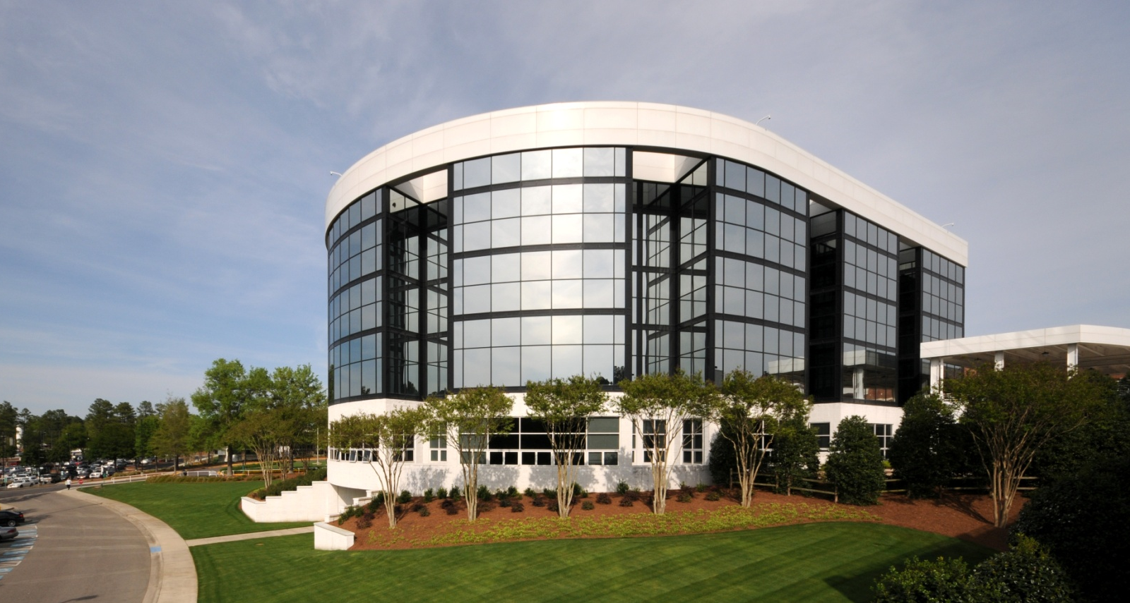
MOORE REGIONAL HOSPITAL

Slide 13
FIRSTHEALTH VALUE DRIVEN INITIATIVES
Bundling for Total Hip & Knee
Bundling for CABG
Hospital Acquired Conditions
Publicly Reported Measures
Re-Admissions
Patient Satisfaction

Slide 14
FIRSTHEALTH PHYSICIAN QUALITY COMMITTEE
Community and FH Physicians
Drive Quality and Outcomes
ABIM’s “Choosing Wisely” Initiative

Slide 15
ROI VALUE DRIVEN HEALTHCARE
PROVIDERS
HOSPITALS
Re-Admissions
Hospital Acquired Conditions
Public Reported Conditions
Meaningful Use
EMR

Slide 16
ROI VALUE DRIVEN HEALTHCARE
PROVIDERS
HOSPITALS
Bundled Payments
Gainsharing
Co-Management Services

Slide 17
PINEHURST SURGICAL & ACO
PINEHURST
SURGICAL
FH
HOSPITAL
SYSTEM
PRIMARY
PROVIDERS

